Slide 1
Moo-Sic
Mood-Based Personalized Song Recommender System

Slide 2


TEAM MEMBERS
Mudit Gupta
2020315
mudit20315@iiitd.ac.in
Siya Garg
2020577
siya20577@iiitd.ac.in
Srishti Jain
2020543 srishti20543@iiitd.ac.in
Sumit Soni
2020136 sumit20136@iiitd.ac.in

Slide 3
MOTIVATION
Songs are the best way to cheer someone up. However, choosing the appropriate song becomes tedious and annoying at that moment. Hence, we came up with classifying the user's mood and then suggesting a song based on their interests.
In this project, we aim to recommend songs to users by recognizing their moods using
facial expressions while also considering the genres of their interest.

Slide 4
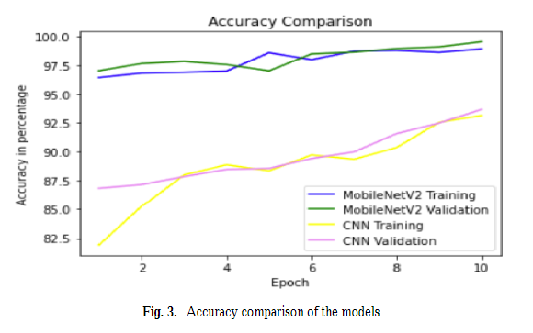
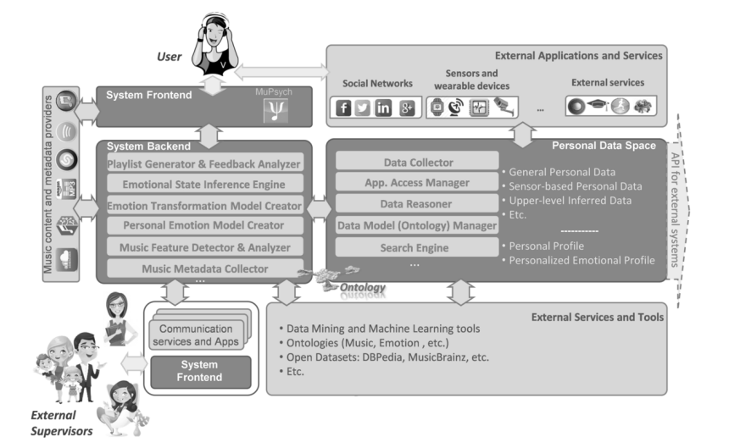
LITERATURE REVIEW
The paper on the transfer learning approach for Face Recognition using Average Pooling and MobileNetV2 discusses improvising facial recognition technology. The research focuses on the implementation of 2 different facial recognition model classifiers: Average Pooling and MobileNetV2, and also draws a comparison between the results of both.
The paper concluded that MobileNetV2 has a higher accuracy rate compared to CNN with average pooling.
The paper Emotion-Based Music Recommender System discusses personalized emotion-driven music recommendation systems. The approach presented in this study is targeted to provide maximum user benefits from the music-listening experience. It emphasizes the fact that to change an emotional state of a user, the main function of the system is to search for the nearest music tracks, which are defined by a certain set of music-related attributes.

Slide 5
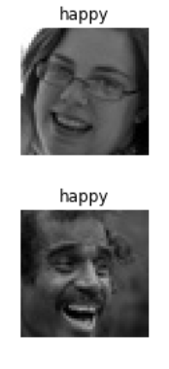
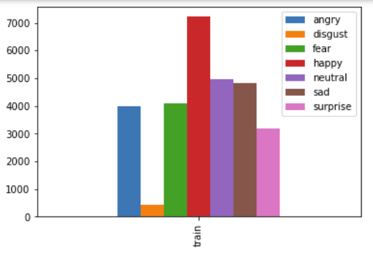
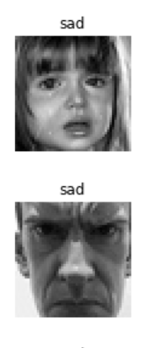
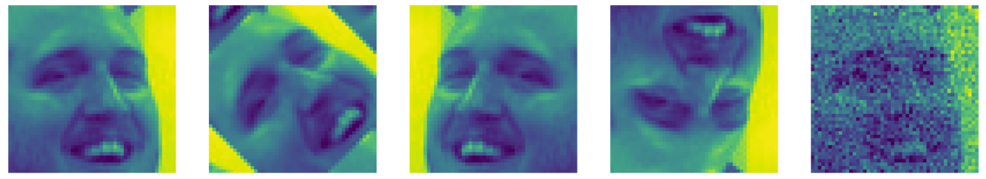
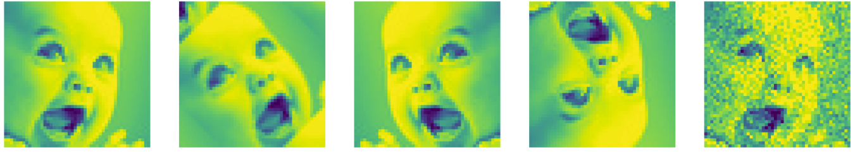
DATA DESCRIPTION: FER-2013 DATASET
FER Dataset (link)
The publicly available data consists of 48x48 pixel grayscale images of faces. The facial expression falls into one of the seven categories (Angry, Disgust, Fear, Happy, Sad, Surprise, and Neutral) . However, we require only 2 classes, Happy and Sad, for our recommender system. An equal number of images (1000) of Sad and Happy are taken from this dataset.
For preprocessing: The input images are of size 48*48 pixels. As our models work on RGB images and require different input image sizes, we reshaped our images accordingly and extended them to 3 dimensions through duplicacy.
This plot tells about the imbalanced class distribution in the FER dataset. To have a class balance, we chose 1000 images from the 2 classes, happy and sad.
Data augmentation increases the amount of data by adding slightly modified copies of already existing data. We did this to reduce overfitting when training a machine learning model.
Data augmentation:

Slide 6
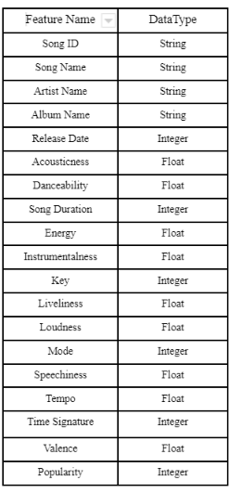
DATASET DESCRIPTION: SPOTIFY DATASET
The dataset has been extracted from the Spotify’s publicly available API. However, due to rate limiting restrictions we were getting multiple error responses for our HTTP GET requests.
So, we used a free to use Spotify library for python to send requests and receive information from the Spotify server. This information included meta-data and audio-features for all the songs.
For every song we have extracted the following features along with their data types (as shown in the table)
We used the Spotify library to access the Spotify API for song information retrieval. First, we chose 18 genres from a total of 126 unique genres available on Spotify. We obtained information on 18,000 songs using 1000 random songs of each genre. Since Spotify has recently restricted the offset limit to 1000, we could not extract more songs using our query

Slide 7
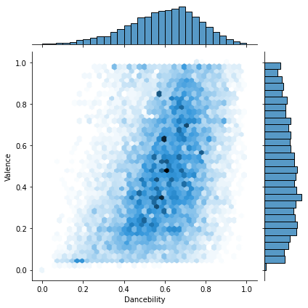
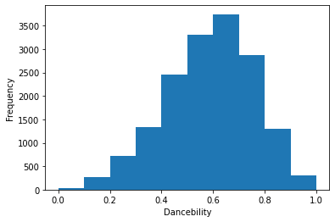
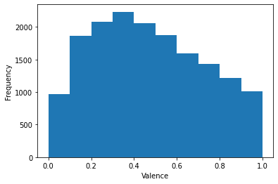
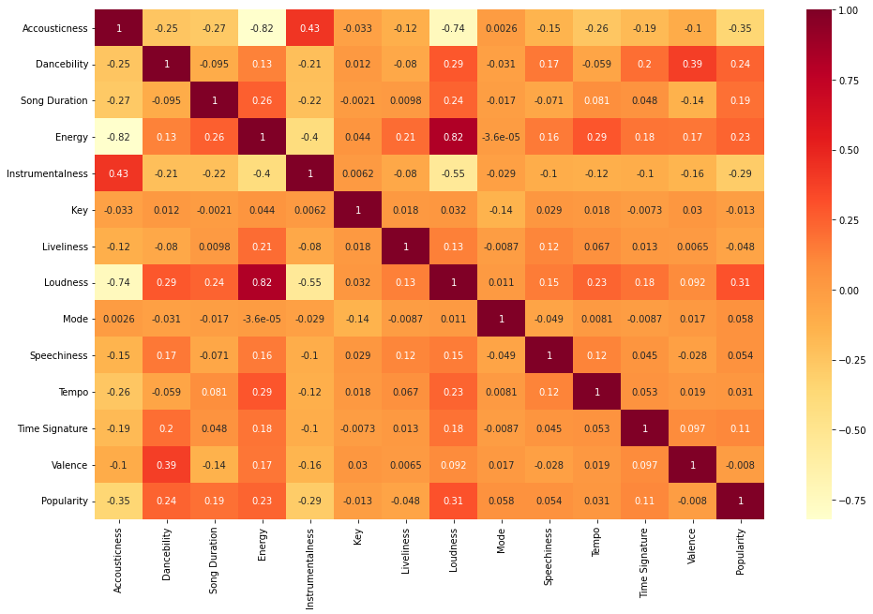
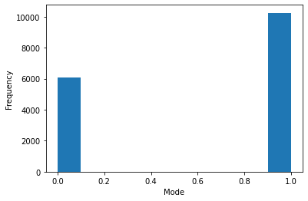
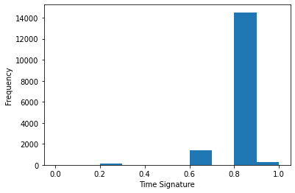
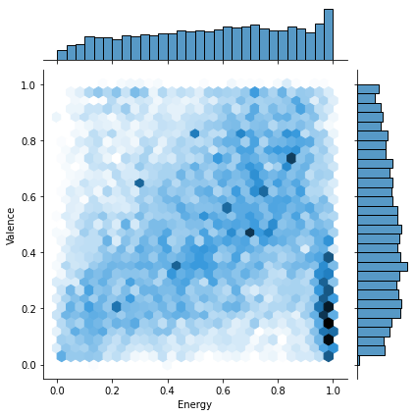
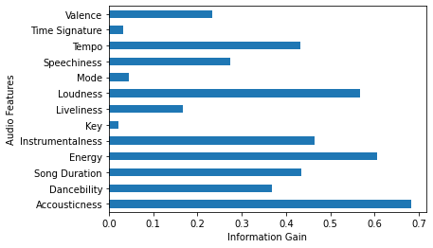
DATASET DESCRIPTION: SPOTIFY DATASET
Correlation Matrix
Frequency plots for a) Danceability and b) valence is distributed over a range. On the other hand, c) Time Signature and d) Mode contain only 4 unique values for the entire dataset.
Here, we can see that some features are distributed well over a range, while others mainly had the same value throughout the dataset. Thus, they perform a minimal role with our genre prediction and emotion score task and hence are mostly dropped during the feature selection task.
Features like valence, danceability, and energy contribute highly to emotion score prediction tasks, which is verified by the correlation graph as shown above.
Information Gain Graph

Slide 8
METHODOLOGY
The main objective of the facial recognition model is to correctly classify the images into 2 classes: Happy and sad.
This is achieved through CNN deep learning models.
The input image sizes are changed as per model requirement, and data augmentation (rotation, shifting, flipping) is applied.
Ratio of Training Set Size:Validation Set Size: 85:15 ratio to prevent overfitting. Different inbuilt CNN models are trained. This was downloaded and used for prediction.
Loss Function Used: Categorical_crossentropy loss
Optimizer: Adam optimizer with a learning rate of 0.001.
Transfer learning: A machine learning technique where a model trained on one task is re-purposed on a second related task, allowing rapid progress or improved performance when performed on another task.
Due to computational power constraints, fine-tuning wasn’t implemented.
VGG16 model: very small (3 × 3) convolution filters are used. It pushed the depth to 16–19 weight layers,
making it approximately 138 trainable parameters.
Inception_V3 model: It has a total of 42 layers and a lower error rate than its predecessors.
MobileNetV2 model: There are two types of blocks. One is a residual block with a stride of 1. Another
one is a block with a stride of 2 for downsizing.
A python script is made, which takes 5 images of the user with a delay on each image of 3 sec.

Slide 9
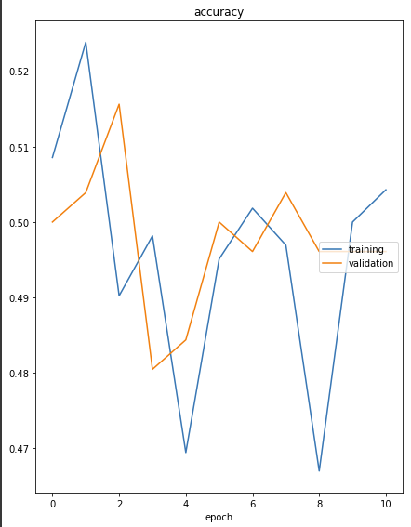
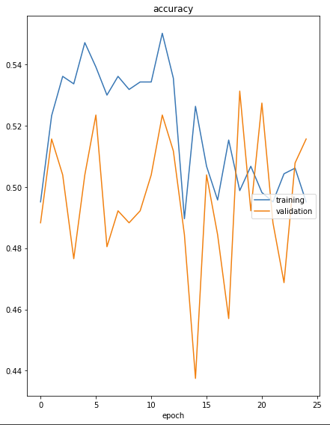
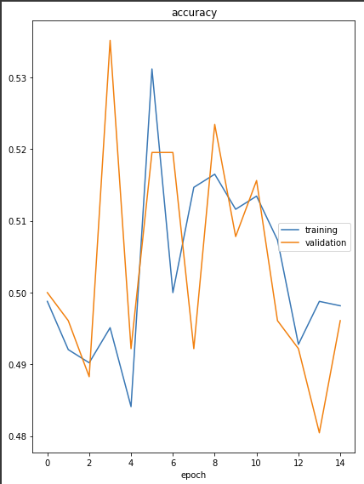
RESULT & ANALYSIS
The accuracy of VGG16 came out to be greater than both InceptionV3 and MobileNetV2. Having, Vgg16 having the best of accuracy while applying the same transfer learning operation on all the models, we will be proceeding with using this model for later on.
Accuracy of Inception_V3
Validation Set: 84.5% Testing Set: 82%
Accuracy of Vgg16
Validation Set : 88.5%
Testing Set: 89%
Accuracy of MobileNetV2
Validation Set: 79.5%
Testing Set: 78% on

Slide 10
TIMELINE
To date, we managed to follow the tentative timeline we had proposed. We have curated the datasets, trained and tested a model for mood prediction based on facial data input, and received a satisfying result.
In the future, we plan to work on -
Hyper-parameter tuning along with the comparison-based analysis for different algorithms for the music and mood scores.
We plan to finish this by 15 November 2022.
Creating a recommender system that can suggest songs based on their interests. This has been planned to
be completed till by 21 November 2022.
Creating a pipeline that can aggregate both results to develop a final list of
recommended songs. This is the final step and the tentative date for this has been
decided as 31 November.
We will then utilise the remaining time to write a proper project report and
create a suitable presentation for the same.

Slide 11
INDIVIDUAL EFFORTS
Mudit Gupta: Literature review, Data Extraction and Collection, Extraction and EDA of Spotify dataset, Analysis and inference of the data and results.
Siya Garg: Literature review, Data Extraction and Collection, EDA, feature selection and data augmentation of FER 2013 dataset, Analysis and inference of the data and results.
Srishti Jain: Literature review, Data Extraction and Collection, Extraction and EDA of Spotify dataset, Analysis and inference of the data and results.
Sumit Soni: Literature review, Data Extraction and Collection, working of the
Facial recognition model, Analysis, and inference of
the data and results.
Drive folder containing all related material : link

